Slide 1
GPU Programming

Slide 2
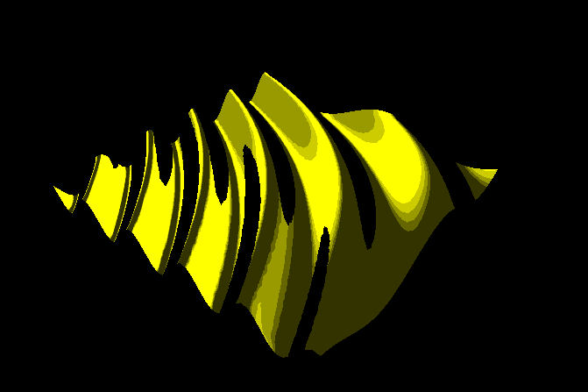
Toon Shading
varying in vec3 N; varying in vec3 V; const float PI = 3.141592; void main (void) { N = normalize(N); vec3 L = normalize(gl_LightSource[0].position.xyz - V); vec3 E = normalize(-V); vec3 R = normalize(-reflect(L,N)); vec3 H = (N+L)/2.0; vec2 alpha = vec2(10.0, 10.0); float d = alpha.x*H.x*H.x + alpha.y*H.y*H.y; float brdf = min( 0.5*((1.0-d)*cos(2.0*PI*sqrt(d)) + 1.0), 1.0); if (brdf < 0.2 ) brdf = 0.2; else if (brdf < 0.4 ) brdf = 0.4; else if (brdf < 0.6 ) brdf = 0.6; else if (brdf < 0.8 ) brdf = 0.8; else brdf = 1.0; if (dot(N,E) < 0.4 ) { gl_FragColor = vec4(0.0, 0.0, 0.0, 1.0); } else { gl_FragColor = brdf * vec4(1.0, 1.0, 0.0, 1.0); } }

Slide 3
Texture
Image load
New package needed
Pillow
from PIL import Image import numpy as np import math import Shader def loadImage(imageName) : img = Image.open(imageName) img_data = np.array(list(img.getdata()), np.uint8) return img.size[0], img.size[1], img_data imgW, imgH, myImage = loadImage("baboon.png")

Slide 4
Enable texture mapping
def InitGL(self): …
self.shader = Shader.Shader("vertex.vs", "fragment.fs") imgW, imgH, myImage = loadImage("baboon.png") print("image loaded (w,h) = ", imgW, imgH) glTexImage2D(GL_TEXTURE_2D, 0, GL_RGB, imgW, imgH, 0,
GL_RGB, GL_UNSIGNED_BYTE, myImage) glTexParameterf(GL_TEXTURE_2D, GL_TEXTURE_WRAP_S, GL_REPEAT) glTexParameterf(GL_TEXTURE_2D, GL_TEXTURE_WRAP_T, GL_REPEAT) glTexParameterf(GL_TEXTURE_2D, GL_TEXTURE_MAG_FILTER, GL_LINEAR) glTexParameterf(GL_TEXTURE_2D, GL_TEXTURE_MIN_FILTER, GL_NEAREST) glEnable(GL_TEXTURE_2D)

Slide 5
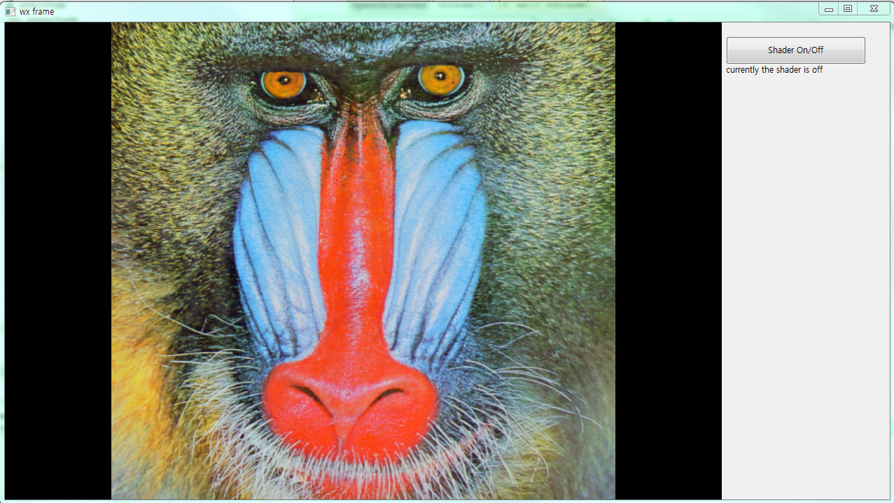
Drawing with texture coord
if self.bDrawWithShader : self.shader.begin() glBegin(GL_QUADS) glTexCoord2fv([0, 1]) glVertex2fv([-1, -1]) glTexCoord2fv([1, 1]) glVertex2fv([1, -1]) glTexCoord2fv([1, 0]) glVertex2fv([1, 1]) glTexCoord2fv([0, 0]) glVertex2fv([-1, 1]) glEnd() self.shader.end()

Slide 6

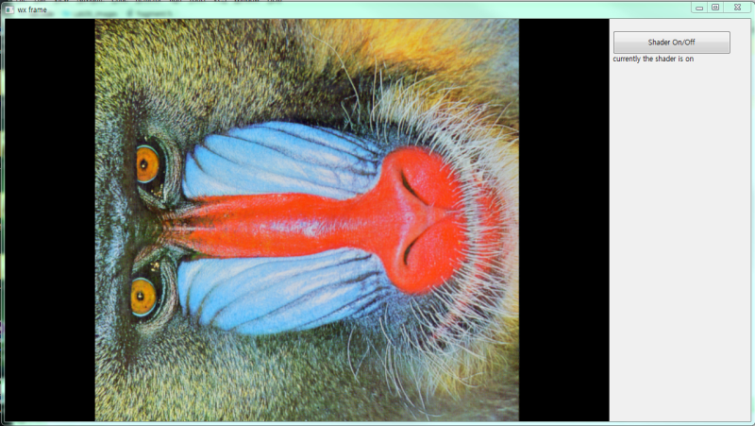
Drawing with Shader
Drawing Code:
if self.bDrawWithShader : self.shader.begin() samplerLoc = glGetUniformLocation(self.shader.program, "myTexture") glUniform1i(samplerLoc, 0); glBegin(GL_QUADS) glTexCoord2fv([0, 1])
Vertex Shader:
void main() { gl_Position = gl_ModelViewProjectionMatrix * gl_Vertex; gl_TexCoord[0] = gl_MultiTexCoord0; }
Fragment Shader:
uniform sampler2D myTexture; void main() { gl_FragColor = texture2D(myTexture, gl_TexCoord[0].yx); }

Slide 7
smoothing
uniform sampler2D myTexture; uniform int imgW, imgH; const int MAXKERNELSIZE = 25; int kernelsize; vec2 offset[MAXKERNELSIZE]; float filter[MAXKERNELSIZE]; void prepare33OffsetMatrix(void) { kernelsize = 9; float S = 1.0/float(imgW); float T = 1.0/float(imgH); offset[0]=vec2(-S, -T); offset[1]=vec2( 0, -T); offset[2]=vec2( S, -T); offset[3]=vec2(-S, 0); offset[4]=vec2( 0, 0); offset[5]=vec2( S, 0); offset[6]=vec2(-S, T); offset[7]=vec2( 0, T); offset[8]=vec2( S, T); } void applyKernel(int size) { vec4 col = vec4(0.0); for (int i=0; i<size; i++) { col += texture2D(myTexture, gl_TexCoord[0].xy+offset[i])*(1.0/9.0); } gl_FragColor = col; } void main() { prepare33OffsetMatrix(); applyKernel(9); }

